Slide 1
Covering Caregiving: Background & Strategies for Reporters
Kaiser Health News Webinar
December 2, 2015
Susan C. Reinhard, RN, PhD, FAAN

Slide 2
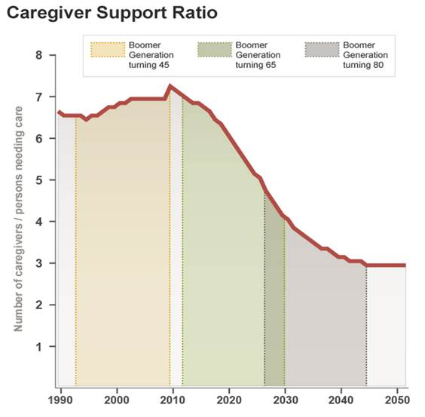
Caregiver Support Ratio
Source: D. Redfoot, L. Feinberg, and A. Houser, The Aging of the Baby Boom and the Growing Care Gap, AARP Public Policy Institute, 2013

Slide 3
Valuing the Invaluable
In 2013, about 40 million family caregivers in the U.S. provided care to an adult with limitations in daily activities
The estimated economic value of their unpaid contributions was about $470 billion in 2013
  from an estimated $450 billion in 2009
Source: Reinhard, Feinberg, Choula & Houser (2015). Valuing the Invaluable: 2015 Update, Undeniable Progress, but Big Gaps Remain, Washington, DC: AARP Public Policy Institute.

Slide 4
How Much is $470 Billion?

Slide 5
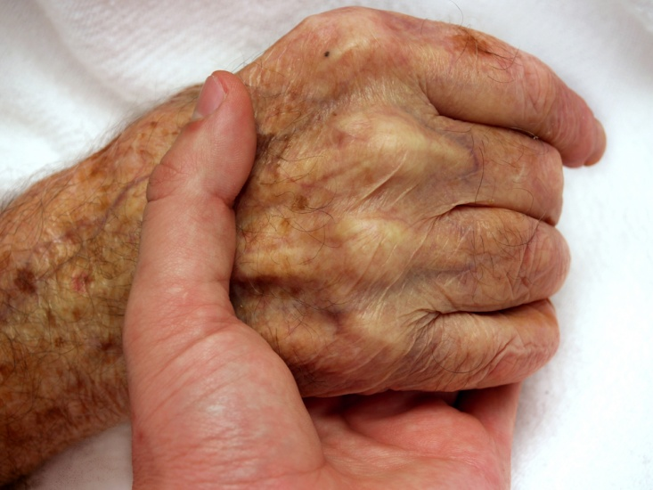
Growing Complexity of Family Care
First emerging trend...
Family caregivers now do medical/nursing tasks in the home

Slide 6
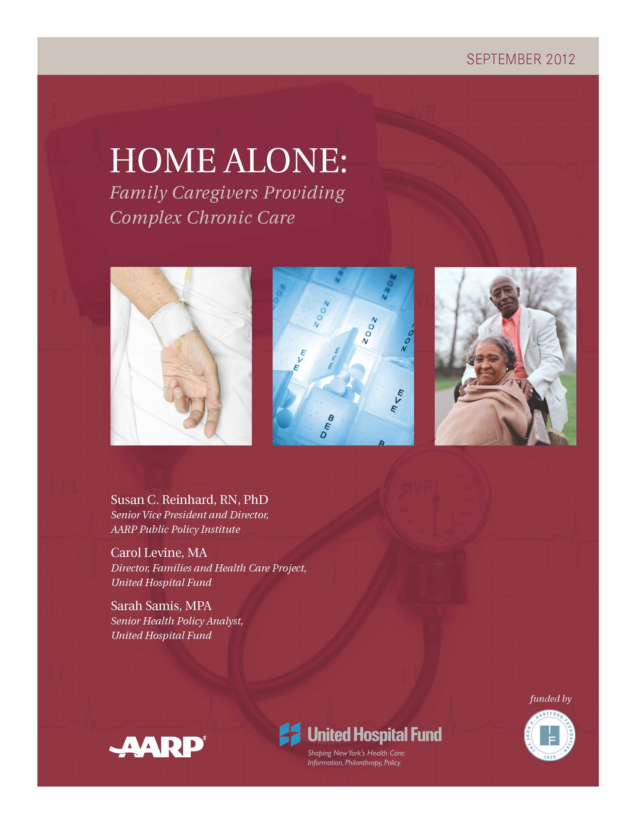
Home Alone Research
AARP Public Policy Institute and United Hospital Fund collaborated on first in-depth national survey of family caregivers in this area
  This report documents:
  What medical/nursing tasks
  family caregivers do;
  What they find difficult;
  Who trains/guides them; and
  Impact on their quality of life.

Slide 7

Medical/Nursing Tasks
Managing complex medications (Poly meds, Injections)
Prepare special food diets
Wound care
Changing catheters
And more…

Slide 8
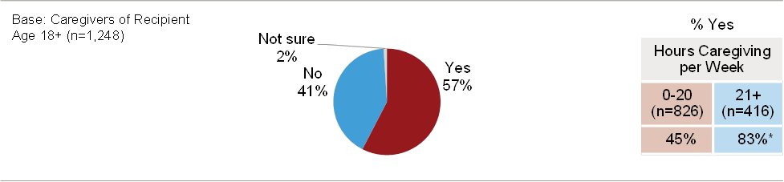
Medical/Nursing Tasks
In addition to ADLs and IADLs, family caregivers are increasingly performing tasks that nurses typically perform. Known now as medical/nursing tasks, these skilled activities include:
injections,
tube feedings,
catheter and colostomy care, and
many other complex care responsibilities.
Higher-hour caregivers are more often performing these tasks.
Breakout of Higher-hour caregivers by Ethnicity:
White: 28%, AAPI: 37%, African American: 39%, Hispanic: 40%
Source: Caregiving in the U.S. 2015 (Bethesda, MD: NAC; Washington, DC: AARP, June 2015).

Slide 9
CARE Act
Opportunity for patient to identify a family caregiver to include in the patient- and family- centered care process...in the record
Notification of discharge
Teaching/anticipatory guidance for family caregiver expected to perform medical/nursing tasks

Slide 10
CARE Act
Give support to nurses and other health and social service professionals to do what their professional standards of practice require them to do
Stimulate new thinking on how to anticipate patient and family questions and pro-actively support them
Reduce hospital re-admissions

Slide 11
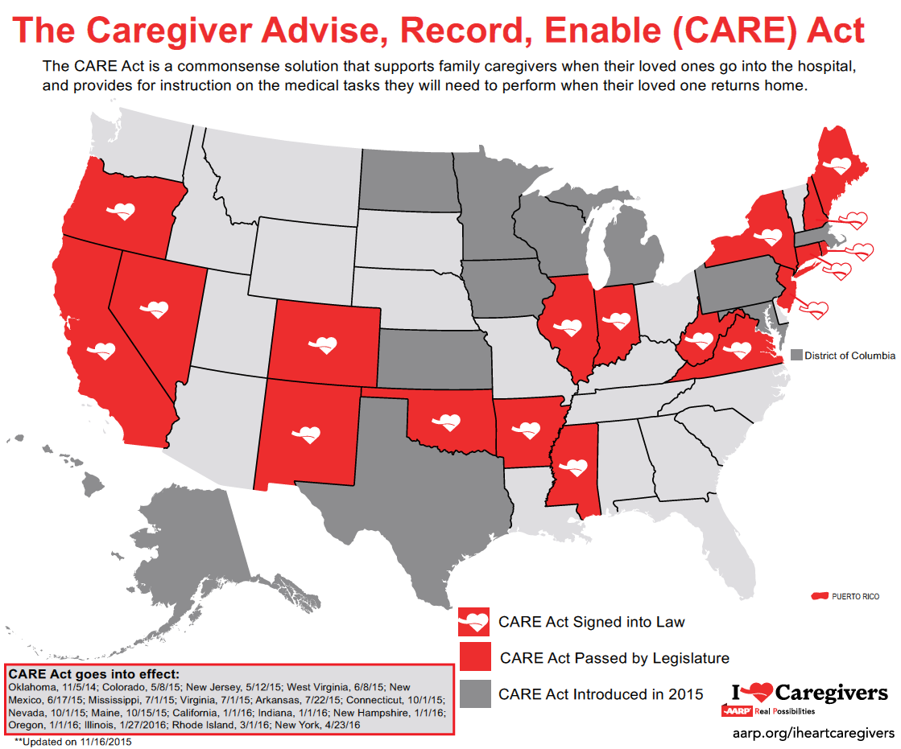

Slide 12
Home Alone Alliance
Alliance of private, non profit, and academic organizations
Change the field, change the culture
Provide quality instructional videos for family caregivers performing complex tasks

Slide 13
Family Caregiver Instructional Videos
Provide instructional vehicle on performing medical/nursing tasks
Audience: Family Caregivers and Nursing Students
First series focusing on medication management

Slide 14
Growing Complexity of Family Care
Second emerging trend...
More family caregivers are in the labor force, juggling demands of work, caregiving and other family responsibilities

Slide 15
Balancing Caregiving and Work
60% of caregivers were employed at some point in the past year while also caregiving. Higher-hour caregivers were more likely to report experiencing nearly all of these work impacts.
Source: National Alliance for Caregiving and AARP Public Policy Institute, Caregiving in the U.S. 2015.

Slide 16

Other Impacts on Work/Caregiving Balance
70% of caregivers who perform medical/nursing tasks reported that caregiving impacted their job
Of those who left their jobs:
  39% quit to have more time to provide care
  34% quit due to lack of job flexibility
  11%--an estimated 2.6 million workers—quit their jobs because they couldn’t afford paid care.
Source: National Alliance for Caregiving and AARP Public Policy Institute,
Caregiving in the U.S. 2015.

Slide 17
Working Caregivers Need Help: Growing National Momentum
Strengthen “family-friendly” workplace flexibility policies
Increase the reach of the FMLA
  Expand coverage for in-laws, grandparents, siblings, other relatives, and protect workers in small businesses (fewer than 50 employees)
Promote access to paid family leave
  3 states: CA, NJ, RI
Promote access to paid sick days (3 to 9 days/yr.)
  3 states and DC: CA, CT, MA (OR’s law effective Jan. 2016)
Protect workers with family caregiving responsibilities from discrimination in the workplace.

Slide 18
Additional Resources
AARP Public Policy Institute www.aarp.org/ppi
Home Alone: Family Caregivers Providing Complex Chronic Care http://www.aarp.org/home-family/caregiving/info-10-2012/home-alone-family-caregivers-providing-complex-chronic-care.html
Valuing the Invaluable 2015 Update http://www.aarp.org/ppi/info-2015/valuing-the-invaluable-2015-update.html
Caregiving in the U.S. 2015 http://www.aarp.org/ppi/info-2015/caregiving-in-the-united-states-2015.html
AARP Caregiver Resource Center www.aarp.org/caregiving
AARP I Heart Caregivers www.aarp.org/iheartcaregivers

Slide 19
Contact:
sreinhard@aarp.org
202-434-3840
@susanpolicy

